Slide 1
GPS Signal Analysis PhnTmAuto Assignment Paul C Liu

Slide 2
Project analysis slide 2
Questions
Based on the two provided dataset gps and signal, answer the following questions.
Which parts of the tested area demonstrate higher / lower quality of the signal?
Does signal quality depend on vehicle’s speed?

Slide 3
Project analysis slide 2
Approach
Approach
Research general quality range of SINR and RSRP by LTE industry for domain knowledge
Conduct brief data discovery for data size, range, type for ETL estimate and tools decision
Use geo map for showing higher vs lower signal in tested area
Use statistical correlation for showing signal quality vs vehicle speed relationship

Slide 4
Project analysis slide 2
Findings
Findings
SINR (quality), RSRP (strength) are both important indicators for connection quality. The higher / lower quality area is as shown in the following PDF file.
https://github.com/liucpaul/phantom_auto/blob/master/Phantom_geomap.pdf
The Power BI geo map link below is interactive and can show different quality thresholds. https://github.com/liucpaul/phantom_auto/blob/master/Phantom_bq.pbix
Signal quality does not depend on vehicle speed.
SINR and RSRP are somewhat correlated, but neither is related with vehicle speed. The following Jupyter Notebook shows the statistics analysis evidence.
https://github.com/liucpaul/phantom_auto/blob/master/Phantom%20Auto.ipynb

Slide 5
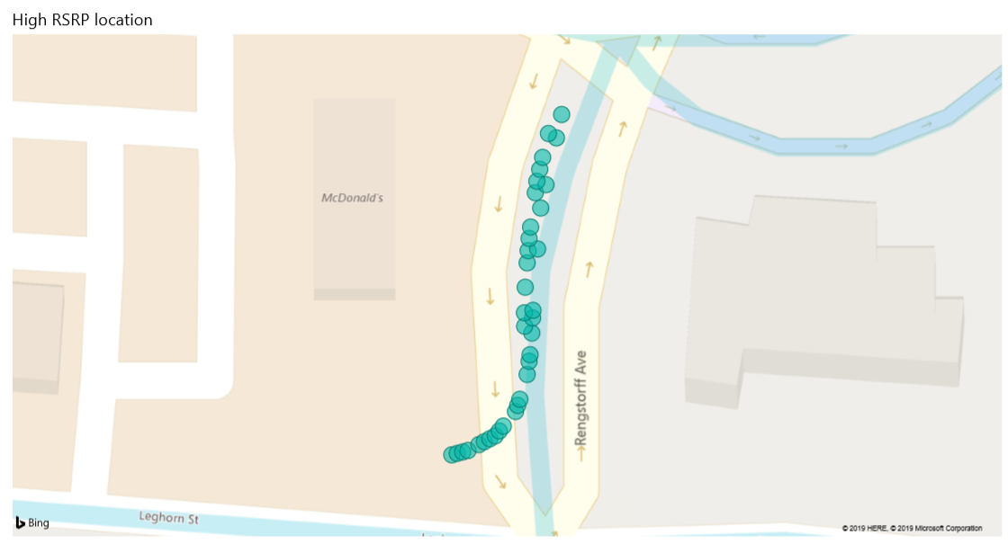
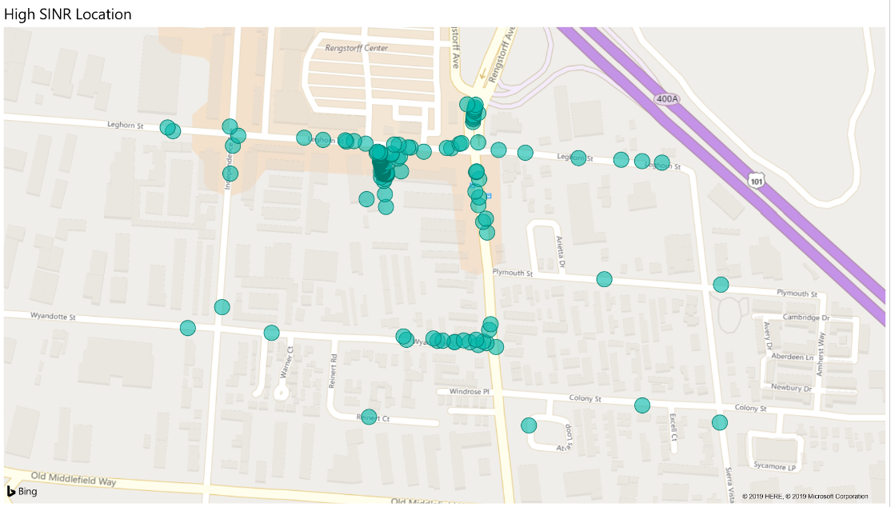
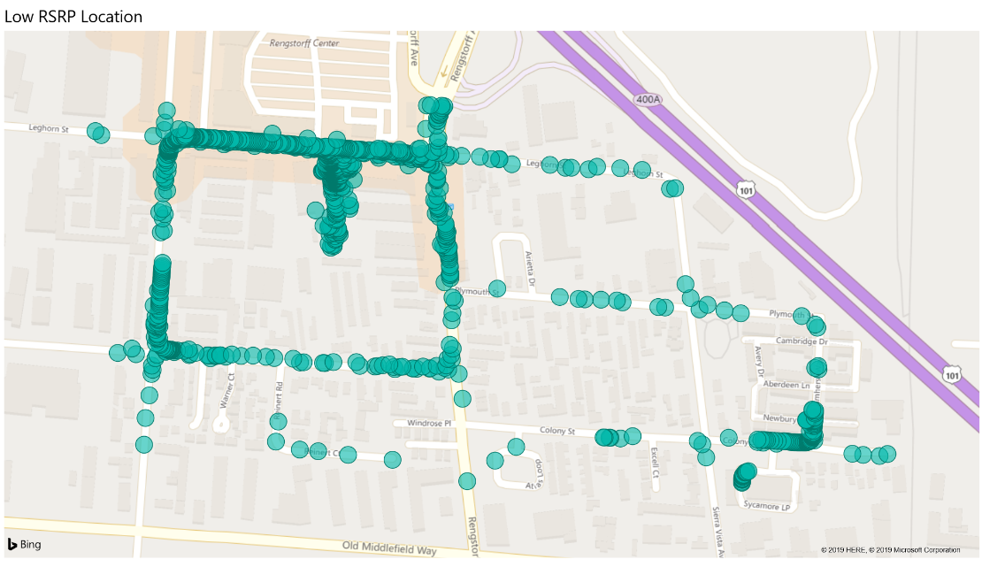
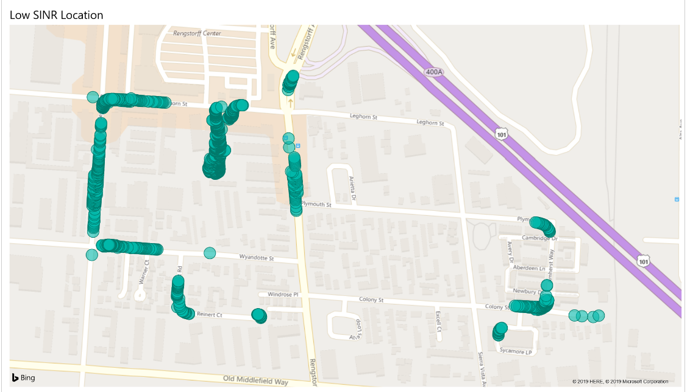
Project analysis slide 2
Geo map snapshots
> 70dbm
> 25dbm
< -110dbm
< -5dbm

Slide 6
Project analysis slide 2
Choice of Tools
GCP Big Query for SQL join – I got GCP already set up
Excel for column split, data type conversion, equations (altitude/longitude distance, speed) – still the most effective equation and conversion tool for small tables
Jupyter Notebook, Python and Pandas to calculate correlation between vehicle speed, SINR, and RSRP
Microsoft Power BI for geo map visualization – Power BI Desktop is free, and integration with Excel is simpler than other tools.

Slide 7
Project analysis slide 2
Steps taken for data preparation
Upload datasets gps and signal to GCP Big Query for SQL Join on connection_id and timestamp for SINR and RSRP at each GPS coordinate.
Export altitude, longitude, SINR, and RSRP as csv file from GCP to Excel for data cleaning, type conversion (particularly time stamp column), and distance calculation based on this equation found on YouTube (https://youtu.be/bzSnw-Iz6O8 Note: There are more accurate equation for altitude and longitude based calcualtion. But for test case in this small town proximity, this equation in YouTube is more than sufficient.)
From Excel csv to Power BI. Use rich ETL and visualization features of Power BI to create signal quality geo maps. The thresholds of high and low quality were chosen to show clearer margin, and can be interactively changed.
Use Python Pandas to read csv and create data frame which has default method for correlation between vehicle speed, SINR, and RSRP.

Slide 8
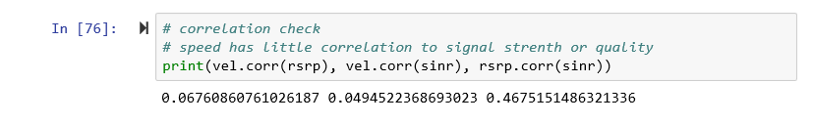
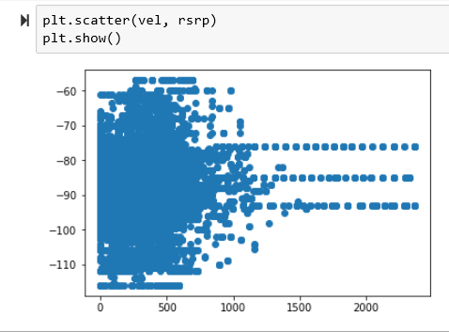
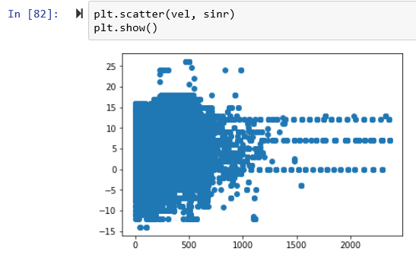
Project analysis slide 5
Jupyter snapshots
Correlation
.049
Small correlation number shows no relationship between signal strength or quality vs vehicle speed.
Scatter plots
Scatter plots show no correlation between signal strength or quality with vehicle speed.

Slide 9
Thank You

